Slide 1

Data Exploration and Preparation
Diploma in DAB – L7
CCT College Dublin
Exploratory Data Analysis
Week 5
Lecturer: Dr. Muhammad Iqbal*
Email: miqbal@cct.ie

Slide 2
Outline
Introduction to Missing Data
Purpose of Data Cleaning
What does Data Cleaning involve?
Documenting the Cleaning Process
Understanding and dropping Missing Data
Replacing Missing Values with a Constant
Imputation using Mean, Median or Mode
Choosing the Appropriate Strategy

Slide 3
Introduction to Missing Data
Missing data refers to values that are not recorded, unavailable, or absent for one or more variables in a dataset.
Why it matters in data exploration and preparation?
Missing values can reduce data quality and affect the accuracy of analysis or machine-learning models.
They may occur because of data-entry errors, unanswered survey questions, system failures, or unavailable information.
During data exploration, missing values should be identified.
During data preparation, they can be handled by removing affected rows/ columns, replacing values through imputation, or keeping them when the absence itself is meaningful.
Example:
If a customer dataset contains Age = blank for some customers, those blank entries are considered missing data.
Notes:
Missing data may appear as:
Blank cells, NULL, NaN, N/A, "Missing", 0, or even special codes such as 99999.
The important question is not only:
“Is the value missing?”
but also:
“Why is it missing?”

Slide 4
Introduction to Data Cleaning
Data cleaning is an essential stage of data preparation. Before analysing a dataset, we need to check whether the data is complete, valid, consistent and suitable for analysis.
We focus on four closely related areas, such as
Data Cleaning
Documenting the Cleaning Process
Handling Missing Data
Dropping, Imputation and Flagging
The main idea is simple: the quality of the analysis depends heavily on the quality of the data provided to the model.

Slide 5
Purpose of Data Cleaning
Raw data is rarely ready for immediate analysis. It may contain missing values, duplicate records, inconsistent labels, incorrect data types, obsolete fields or unusual values.
We emphasise that the database values need both data cleaning and data transformation before exploration can begin.
The purpose is to minimise the effect of poor-quality inputs on the final analysis, commonly described as Garbage In → Garbage Out.
Example: Imagine a supermarket dataset containing customer ages, product prices and transaction values. If ages contain text values, prices contain negative numbers and customer information is incomplete, any analysis may become misleading.

Slide 6
What does Data Cleaning involve?
Data cleaning means examining the dataset for errors and deciding how those errors should be treated.
A value may be technically stored in the database but still be incorrect. For example, a postal code such as 06269 can become 6269 when it is incorrectly stored as a numeric field. Similarly, a categorical field such as gender may simply be blank.
Cleaning involves asking questions, such as
Is this value valid?
Is the data type correct?
Does this value make sense?
Is information missing?

Slide 7
Documenting the Cleaning Process
Data cleaning should be documented so that another person can understand what was changed and why.
A good cleaning record should explain
What problem was identified
Which variable or records were affected
What action was taken
For example: “Three missing age values were replaced using the median age because the distribution was skewed.”
Documentation improves transparency, reproducibility and accountability.
Recommended workflow
Raw Data
Cleaning Steps
Clean Datasets
Cleaning Log

Slide 8
Should we drop missing data?
One possible approach is to delete rows containing missing values. However, this can be risky.
If we delete incomplete records, it may remove valuable information from the remaining fields. The pattern of missingness may also be systematic rather than random.
In the example provided, even a relatively small proportion of missing values could lead to a very large loss of complete records.
If Customer B is deleted, the income information is also lost.
Question: Does deleting the record create more damage than keeping it?
Customer | Age | Income
A | 29 | €42,000
B | Missing | €51,000
C | 44 | €63,000
df = df.dropna()

Slide 9
Replacing Missing Values with a Constant
A simple alternative is to replace missing values with a fixed value selected by the analyst.
For numeric variables, a constant such as 0 may be used. For categorical variables, a label such as “Missing” or “Unknown” may be inserted.
This method replaces missing numeric values with 0.0 and missing category values with “Missing”.
Caution
A constant must not accidentally imply real meaning.
For example, replacing a missing age with 0 may suggest that the customer is a newborn. A separate “Missing” category may be safer when the distinction matters.

Slide 10
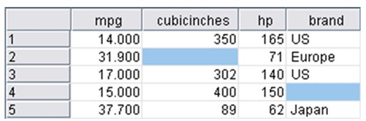
Imputation using Mean, Median or Mode
Another approach is imputation, where missing values are replaced with a reasonable estimate.
For categorical data, the mode may be used.
For numerical data, the mean or median may be suitable.
We replace the missing brand value with mode as US, while the missing cubic-inch value is replaced by the mean value 200.65.
Mean = 285.25, Cubic-inches: 350, missing, 302, 400, 89
Median = 326, After imputation: 89, 302, 350, 400
Imputation keeps the record in the dataset, but the replacement value is an estimate rather than an original observation.

Slide 11
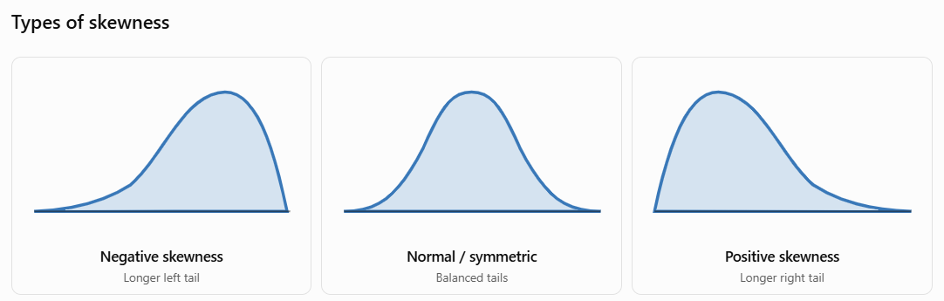
Limitations
Mean and Mode Imputation
Mean or mode imputation can be convenient, but it is not always the best solution.
The mean may not represent a good “typical” value. Replacing many observations with the same value can also reduce variation in the dataset artificially, which may make statistical confidence appear stronger than it really is.
For Example: If salary data is strongly skewed by a small number of very high earners, the mean may be much higher than the salary of a typical employee.
In that case, the median may provide a more appropriate replacement.
Main Principle
Choose the imputation method according to the variable and its distribution.

Slide 12
Flagging Missing or Imputed Values
Age | Age_Missing
25 | 0
31 | 1
38 | 0
A useful technique is to create an additional variable showing whether the original value was missing.
For example: Here, 31 may be an imputed value, while Age_Missing = 1 tells us that the original observation was unavailable.
Flagging helps to preserve information about the original condition of the dataset. It is particularly useful when missingness itself could be meaningful.
For example, customers who do not provide income information may behave differently from customers who do.
Good Practice
Impute the value when appropriate, but keep a record that it was originally missing.

Slide 13
Choosing the Appropriate Strategy
There is no single correct solution for every missing-data problem.
Dropping may be acceptable when only a very small number of observations are affected and their removal is unlikely to introduce bias.
Imputation may be preferable when retaining the observation is important, but the replacement method should be appropriate for the variable and distribution.
Flagging is useful when the fact that a value was missing may itself contain information.
Advanced imputation methods estimate missing values using interpolation, regression, classification trees, or regression trees, based on neighbouring values or relationships with other attributes in the dataset.
Final Cleaning Principle
Inspect
Understand
Clean
Document
Validate

Slide 14
Resources/ References
Pierson, L. (2026) “Data Science For Dummies”. 4th edn. For Dummies. Available at: https://learning.oreilly.com/library/view/data-science-for/9781394424085/
Foxwell, H.J. (2020) Creating Good Data: A Guide to Dataset Structure and Data Representation. Berkeley, CA: Apress. doi: 10.1007/978-1-4842-6103-3.
McGregor, S.E. (2021) Practical Python Data Wrangling and Data Quality. Sebastopol, CA: O'Reilly Media. ISBN 9781492091493.
AI Publishing (2020) Data Preprocessing with Python for Absolute Beginners: Step-by-Step Guide with Hands-on Projects and Exercises. AI Publishing LLC. ISBN 9781734790108.
Kazil, J. and Jarmul, K. (2016) Data Wrangling with Python. Sebastopol, CA: O’Reilly Media, IncOpenAI. (2026).
ChatGPT. OpenAI (CCT Licensed Version).
Some images are used from Google search repository (https://www.google.ie/search) to enhance the level of learning.
Copyright Notice
The following material has been communicated to you by or on behalf of CCT College Dublin in accordance with the Copyright and Related Rights Act 2000 (the Act).
The material may be subject to copyright under the Act and any further reproduction, communication or distribution of this material must be in accordance with the Act.
Do not remove this notice

